Slide 1
Algorithms: Transform and Conquer
For: CSCI 163A / COEN 179
By: Navid Shaghaghi

Slide 2
Introduction
That’s the secret to life . . . replace one worry with another.
—Charles M. Schulz (1922–2000),
American cartoonist,
the creator of Peanuts

Slide 3
Types Of Transform and Conquer
Instance Simplification: Transformation to a simpler or more convenient instance of the same problem.
Representation Change: Transformation to a different representation of the same instance.
Problem Reduction: Transformation to an instance of a different problem for which an algorithm is already available.

Slide 4
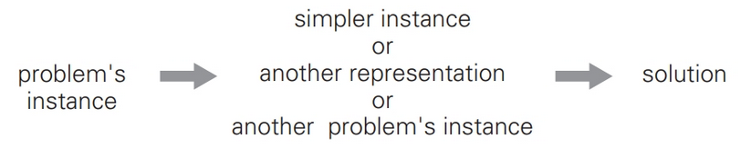
Transform-and-conquer strategy

Slide 5
Presorting
Questions about a list are easier to answer if the list is sorted
Sorting will however incur a time/space cost.
No general comparison-based sorting algorithm can have a better efficiency than n log n in the worst case and average case efficiency.
So, we can assume a presorting step added to the algorithm we are trying analyze.
Needless to say, this is only beneficial if the run time of the algorithm is improved to be less than or equal to n log n on a sorted input.

Slide 6
Example: Checking Element Uniqueness in an Array
The brute-force algorithm compares pairs of the array’s elements until either two equal elements are found or no more pairs are left.
Its worst-case efficiency is in Θ(n²).
The presorting algorithm will first sort the list and therefore only need to check all of the adjacent pairs until it finds a duplicate or reaches the end of the array.
Its worst-case efficiency is in Θ(n log n).

Slide 7
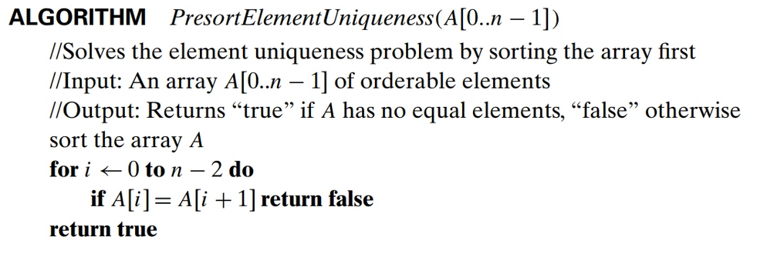
Algorithm

Slide 8
Analysis
T(n) = T_{sort}(n) + T_{scan}(n)
T_{sort}(n) ∈ Θ(n log n)
T_{scan}(n) ∈ Θ(n)
So,
T(n) ∈ Θ(n log n) + Θ(n) = Θ(n log n).

Slide 9
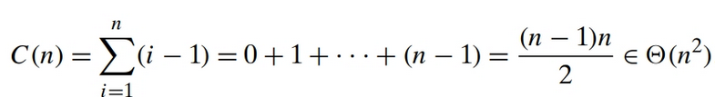
Example: Computing the mode
Mode: a value that occurs most often in a given list of numbers.
For example, for 5, 1, 5, 7, 6, 5, 7, the mode is 5.
The brute-force approach to computing a mode would scan the list and compute the frequencies of all its distinct values, then find the value with the largest frequency.
The worst case occurs when the input list has all unique elements.
Analysis:

Slide 10
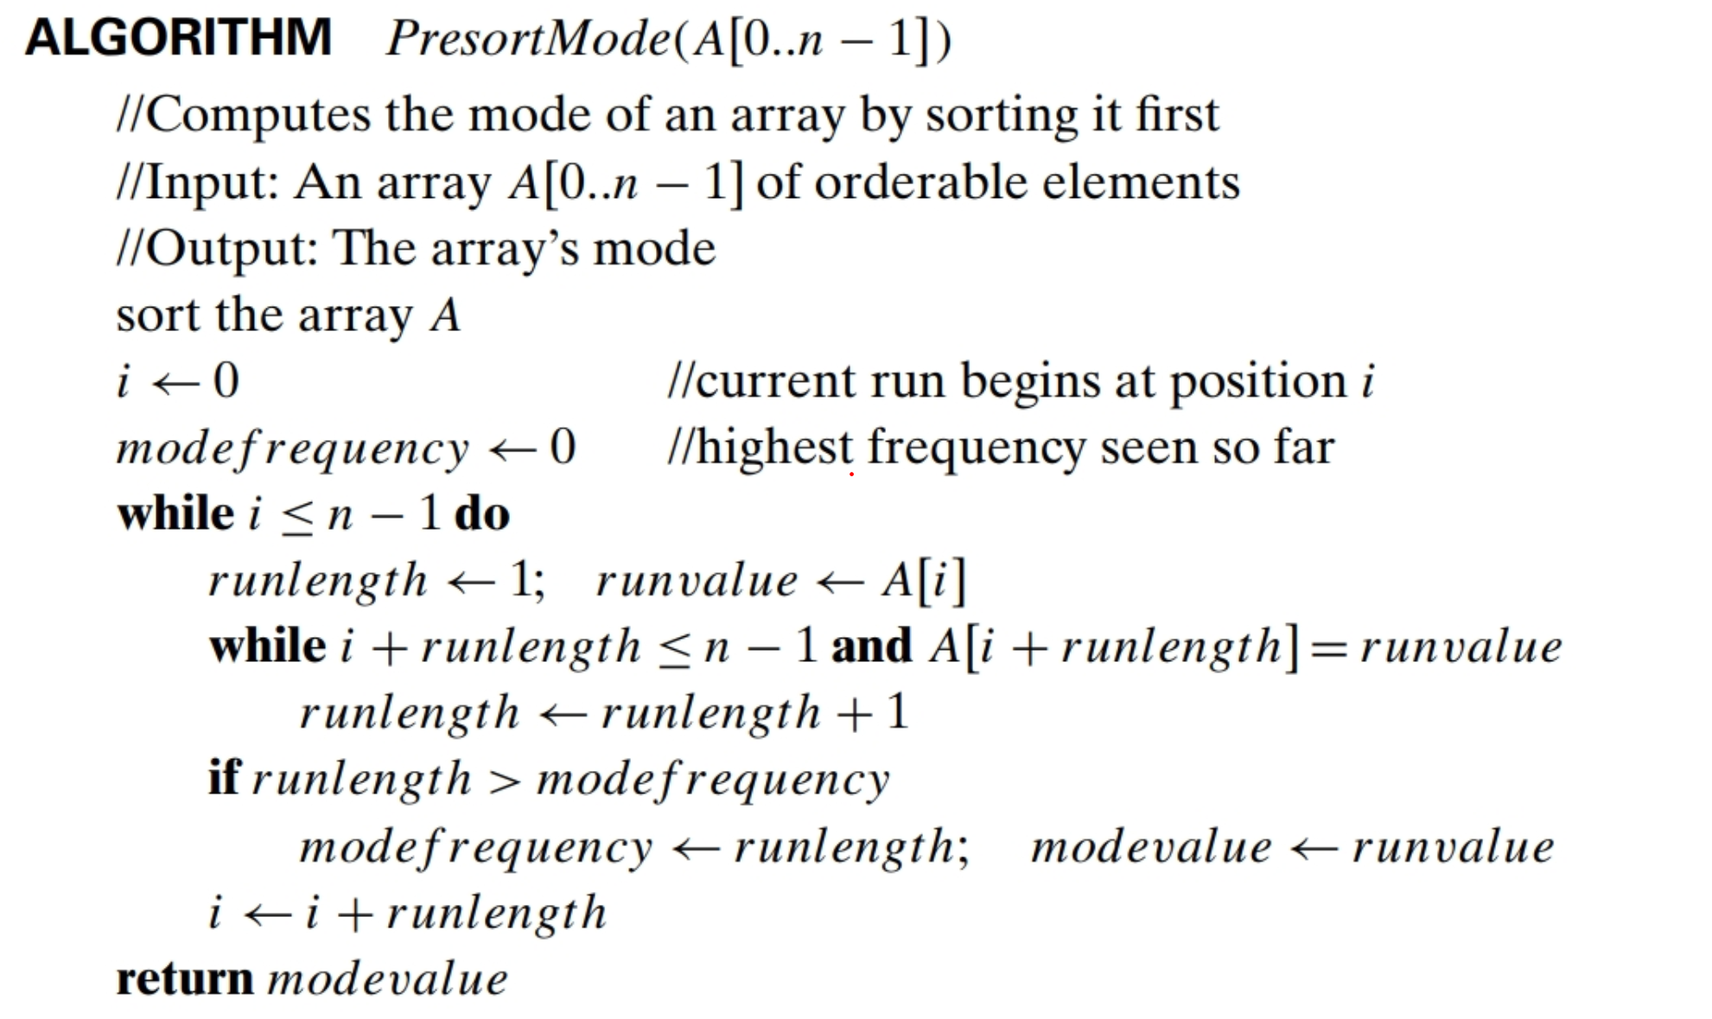

Slide 11
Analysis
T(n) = T_{sort}(n) + T_{search}(n)
T_{sort}(n) ∈ Θ(n log n)
T_{search}(n) ∈ Θ(n)
So,
T(n) ∈ Θ(n log n) + Θ(n) = Θ(n log n).

Slide 12
Presorting is not always better than Exhaustive Search
Example: Searching for an item in an array
T_{exhaustive_search}(n) ∈ Θ(n)
T_{Presorting}(n) = T_{sort}(n) + T_{binary_Seach}(n) Where
T_{sort}(n) ∈ Θ(n log n)
T_{binary_Seach} (n) ∈ Θ(log n)
So,
T_{Presorting} (n) ∈ Θ(n log n) + Θ(n) = Θ(n log n) > Θ(n) → Presorting is inferior

Slide 13
Gaussian Elimination
We are skipping this section.

Slide 14
Balanced Search Trees
Balanced tree varieties:
instance-simplification variety: an unbalanced binary search tree is transformed into a balanced one.
Examples:
AVL Tree
Red-black tree
representation-change variety: allow more than one element in a node of a search tree.
Examples:
2-3 trees
2-3-4 trees
B-trees

Slide 15
AVL Trees
See slides 15 – 21 of textbook slides.

Slide 16
2-3 Trees
See slides 22 – 25 of textbook slides.

Slide 17
Heaps and Heapsort
See CSCI 61 – Heaps slides
See slides 26 – 37 of textbook slides.

Slide 18
Horner’s Rule
Problem: computing the value of a polynomial p(x)=a_{n}x^{n} +a_{n−1}x^{n−1} +...+a₁x +a₀
Horner’s Rule: An optimal algorithm for polynomial evaluation without preprocessing the polynomial’s coefficients. (Used by Isaac Newton 150 years before Horner published it.)
A good example of the representation-change technique since it is based on representing p(x) by a formula different from above.
This new formula is obtained by successively taking x as a common factor in the remaining polynomials of diminishing degrees: p(x)=(...(a_{n}x +a_{n−1})x +...)x +a₀.

Slide 19
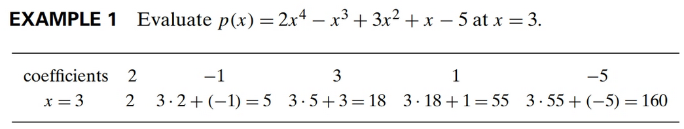
Example
p(x) = 2x⁴ − x³ + 3x² + x − 5
= x(2x³ − x² + 3x + 1) − 5 = x(x(2x² − x + 3) + 1) − 5
= x(x(x(2x − 1) + 3) + 1) − 5.

Slide 20
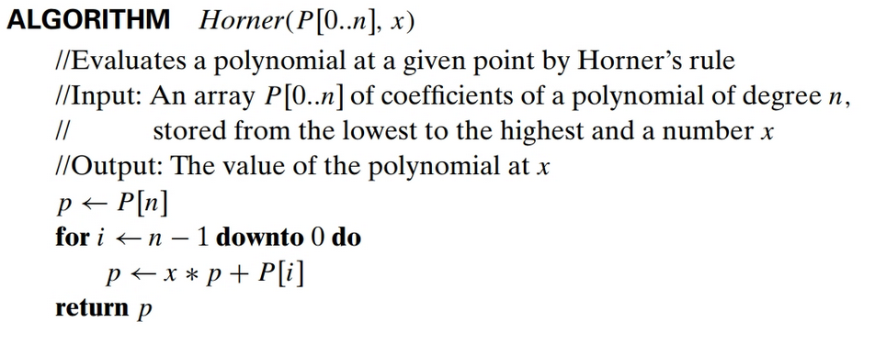
Algorithm

Slide 21
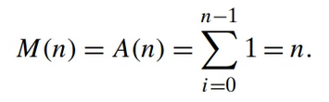
Time Efficiency Analysis
To appreciate how efficient Horner’s rule is, consider only the first term of a polynomial of degree n: a_{n}x^{n}. Just computing this single term by the brute- force algorithm would require n multiplications, whereas Horner’s rule computes, in addition to this term, n − 1 other terms, and it still uses the same number of multiplications!

Slide 22
Synthetic Division
A useful byproduct of Horner’s Rule:
The intermediate numbers generated by the algorithm in the process of evaluating p(x) at some point x₀ turn out to be the coefficients of the quotient of the division of p(x) by x − x₀, and the final result, in addition to being p(x₀), is equal to the remainder of this division.
Thus, according to Example 1, the quotient and the remainder of the division of 2x⁴ − x³ + 3x² + x − 5 by x − 3 are 2x³ + 5x² + 18x + 55 and 160, respectively.

Slide 23
Problem Reduction
If you need to solve a problem, reduce it to another problem that you know how to solve. (Remember the Joke about Engineer boiling water.)
Examples:
Lowest Common Multiple (lcm) of two number
Counting Paths in a Graph
Reduction of Optimization Problems (Maximization ←→ Minimization)
Linear Programming
Reduction to Graph Problems

Slide 24

Least Common Multiple (LCM)
The least common multiple of two positive integers m and n, denoted lcm(m, n), is defined as the smallest integer that is divisible by both m and n.
Example: lcm(24, 60) = 120
24 = 2 . 2 . 2 . 3,
60 = 2 . 2 . 3 . 5,
lcm(24, 60) = (2 . 2 . 3) . 2 . 5 = 120.
Or

Slide 25
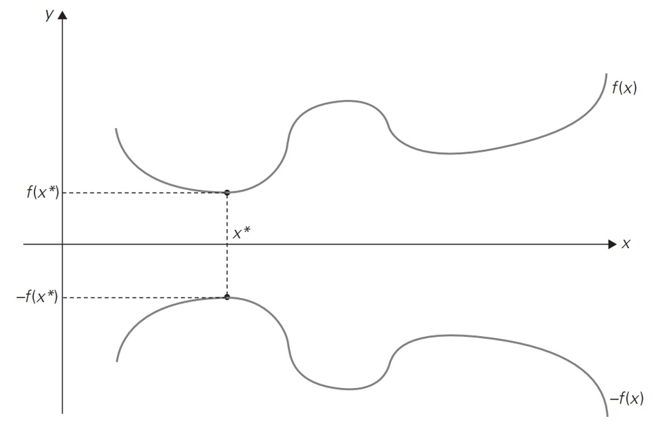
Reduction of Optimization Problems
min f (x) = − max[−f (x)]
max f (x) = − min[−f (x)]

Slide 26
Reduction to Graph Problems
State-space graph: vertices of a graph typically represent possible states of the problem in question, and edges indicate permitted transi- tions among such states.
Example: peasant, wolf, goat, and cabbage puzzle

Slide 27
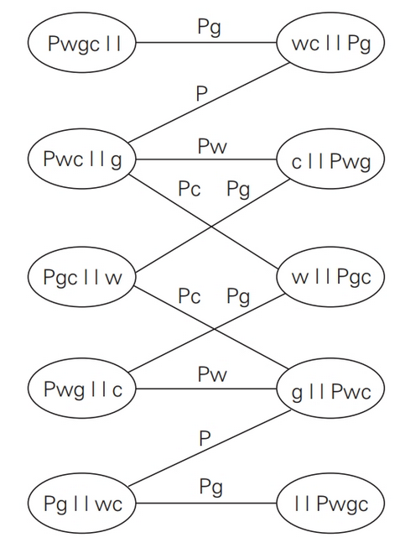
Peasant, Wolf, Goat, and Cabbage puzzle

